Slide 1
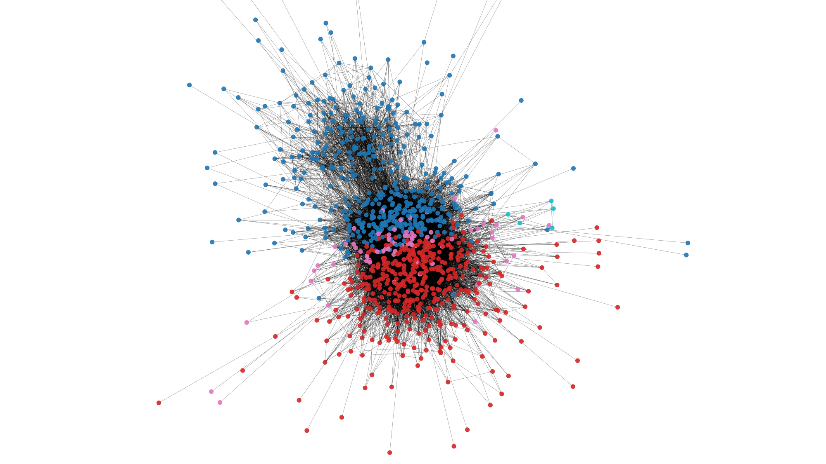
Bot Detection in Social Graphs Using Network-Based Features
Murariu Tudor Cristian

Slide 2

What are social bots? Why they’re a problem?
Social Bots are automated accounts on social media that mimic human behavior to spread content, interact with users, or manipulate discussions.
Social media platforms are increasingly targeted by automated accounts
Bots can amplify misinformation, distort public opinion, or spam users.
Traditional detection methods focus on content analysis or user behavior.
This presentation explores a structure-based approach: detecting bots through social graphs.

Slide 3
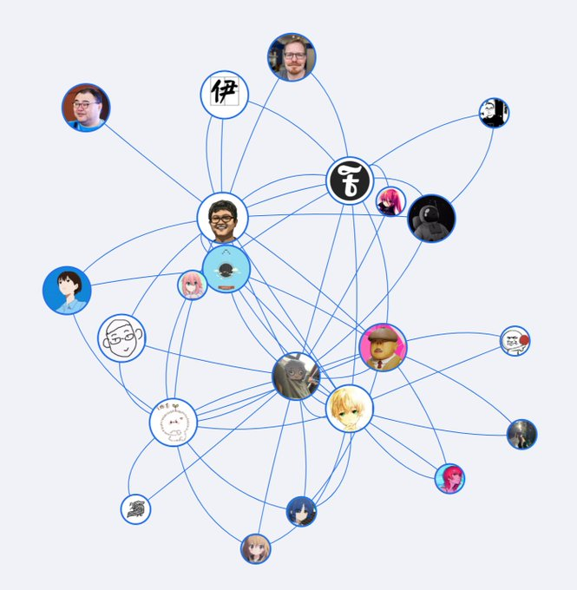
What is a Social Graph?
Graph where users = nodes, interactions = edges
Edge types: follows, replies, mentions, retweets, likes/reacts, comments, etc.

Slide 4
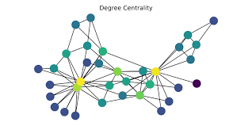
Fundamentals of Social Network Analysis
Degree Centrality: number of connections a node has
Betweenness Centrality: how often a node lies on the shortest path between others
Clustering Coefficient: measures how connected a node’s neighbors are
Ego Networks: a user’s immediate local network

Slide 5
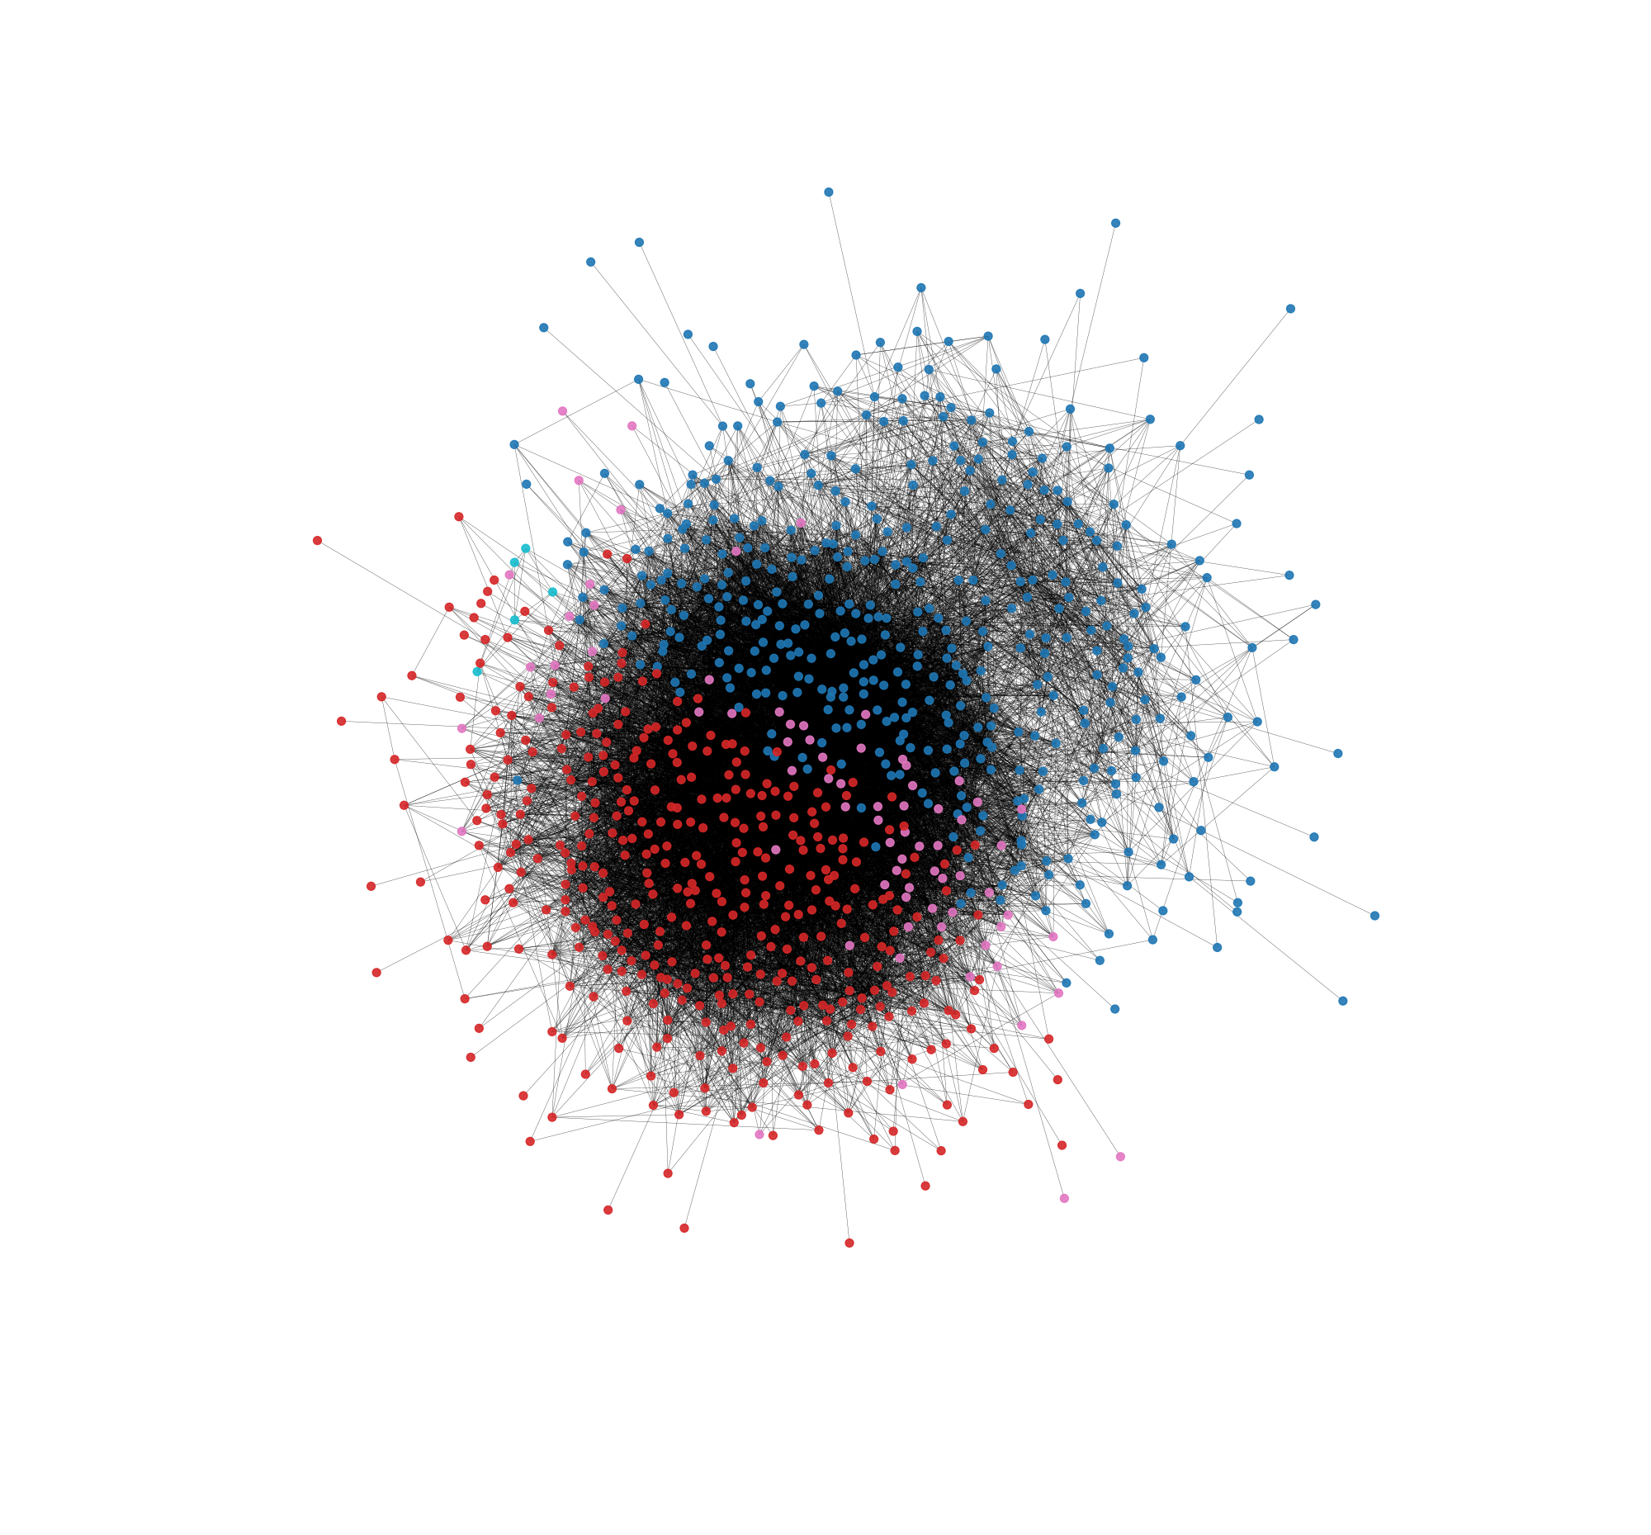
How Can SNA Concepts Be Used in Social Media?
Influencers → Detected using high centrality metrics (e.g., degree, betweenness, closeness) → These users are key hubs in the network
Isolated Users → Identified by low degree or as part of disconnected components → May represent inactive accounts or outliers
Anomalous Patterns → Detected through unusual clustering coefficients, abnormal centrality, or odd graph positions → Useful for spotting bots, spam clusters, or coordinated campaigns

Slide 6
Why Network-Based Detection?
Doesn’t require message content (privacy-friendly)
Bots show structural patterns: high out-degree, low clustering, etc.
Scalable to large networks

Slide 7
Network-Based Features
Feature | Description | Bot Signature
Out-degree | # of users followed | Often very high
Clustering coefficient | Local triangle density | Often near 0
Betweenness centrality | Bridge roles | Often low
K-core participation | Embeddedness | Often outside core, Low Embeddedness

Slide 8

Detection Techniques
🔹 Unsupervised Techniques
Use graph anomalies and structural patterns
Examples:
Outlier detection on centrality metrics
Clustering-based methods (e.g., DBSCAN, community detection)
Effective when labels are unavailable
🔹 Supervised Techniques
Use labeled data to train classifiers (e.g., Random Forest, SVM)
Input features:
Degree, clustering coefficient, betweenness, etc.
Often outperform unsupervised models with quality data
🔹 Graph-Based Models
Advanced methods like Graph Neural Networks (GNNs)
Capture complex structures in local and global connectivity
Recent trend in bot detection research

Slide 9
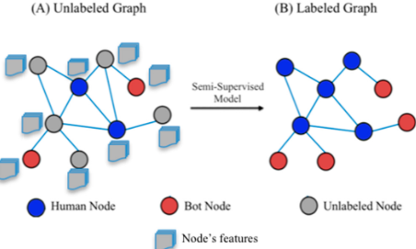
Challenges in Bot Detection
🔹 Evasion Tactics
Bots are evolving to mimic human-like behavior and network patterns
Makes structural detection increasingly difficult
🔹 Data Access Limitations
Social media platforms restrict access to full graph data
Limits availability of high-quality training and evaluation datasets
🔹 Labeling Ground Truth
Manually labeling bots vs. real users is time-consuming and error-prone
Lack of consensus on what defines a “bot”
🔹 False Positives
Some legitimate users may exhibit bot-like patterns (e.g., influencers, brands)
Risk of misclassifying real users

Slide 10
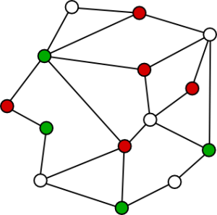
Conclusion
✅ Network-based detection offers a powerful, content-independent way to identify social bots
✅ Social Network Analysis (SNA) metrics reveal structural anomalies in user behavior
✅ Techniques include both unsupervised and supervised methods, as well as emerging graph-based models
✅ Despite promising results, key challenges remain: evasion, data access, and scalability

